Slide 1
NODE.JS
(The Backend Of MERN Stack)
Lecture 31

Slide 2
Today’s Agenda
The Mongo Query Language
Using find() Method
Applying Criteria
Applying Projection
Using findOne() Method

Slide 3
Mongo query Language
MongoDB Query Language is a way to get the data from the MongoDB database.
While performing a query operation, one can also use criteria or conditions which can be used to retrieve specific data from the database.
It’s similar to SELECT queries in SQL.

Slide 4
Methods for Querying documents
MongoDB provides two methods for finding documents from a collection:
find() - returns a cursor to the selected documents that matched with the specified criteria.
findOne() - returns a the first document that matched with the specified criteria.

Slide 5
Using the “find()” method
To query the data from MongoDB collection, we need to use MongoDB's find() method.
Syntax:
db.<collection_name>.find(query,projection,options)
db.<collection_name>.find(query,projection,options).pretty()
The method find() will display all the documents in the given collection in unformatted way while pretty() will display them in a formatted way.

Slide 6
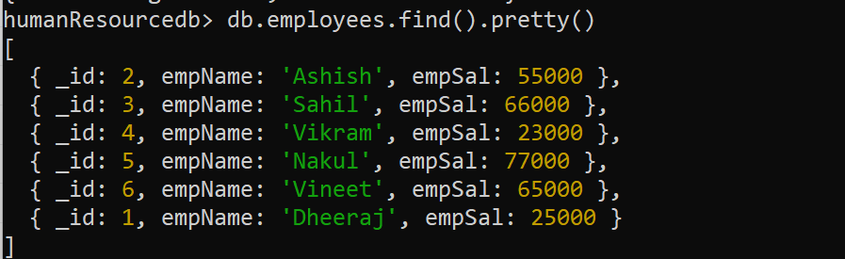
Example

Slide 7
Specifying criteria
We can specify the criteria as { field: "value", field:"value",..} on which we want to find a document.
For example, the code shown on next slide returns all the documents where salary is 23000.

Slide 8
Example

Slide 9
Specifying criteria
In case the criteria doesn’t match we will get an empty cursor as the return value.

Slide 10
Mongodb query operators
Query operators provide ways to locate data within the database.
They are alternates of WHERE clause of RDBMS like Oracle or MySQL and have the following general syntax
db.<collection_name>.find({ <field1>: { <operator1>: <value1> }, ... })

Slide 11
Mongodb query operators
Operator | Purpose
$eq | Matches values that are equal to a specified value.
$gt | Matches values that are greater than a specified value.
$gte | Matches values that are greater than or equal to a specified value.
$in | Matches any of the values specified in an array.
$lt | Matches values that are less than a specified value.
$lte | Matches values that are less than or equal to a specified value.
$ne | Matches all values that are not equal to a specified value.
$nin | Matches none of the values specified in an array.

Slide 12
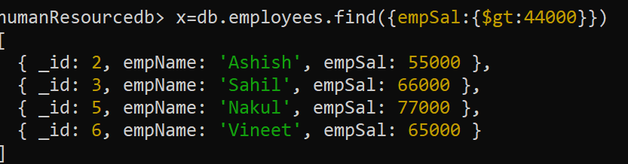
query operator Examples
Fetching records of all employees who earn more than 44000

Slide 13
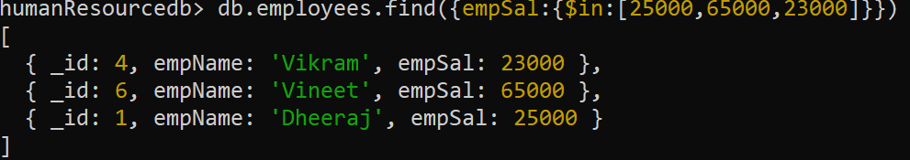
query operator Examples
Fetching records of all employees who earn 25000,65000 or 23000

Slide 14
Specifying and
If we supply criteria for more than one field in the collection's documents it implicitly becomes a logical AND .
Thus the query selects the documents in the collection that match all the conditions.

Slide 15
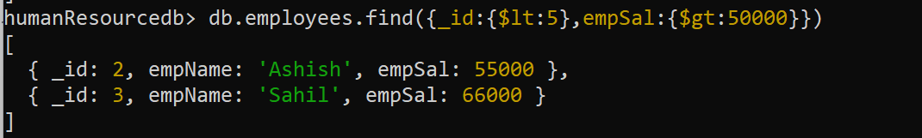
Specifying and
Fetching records of all employees whose _id is less than 5 and have a salary of more than 50000.

Slide 16
Specifying or
We use the $or operator to specify a query that joins each clause with a logical OR conjunction .
Thus the query selects the documents in the collection that match at least one condition.

Slide 17
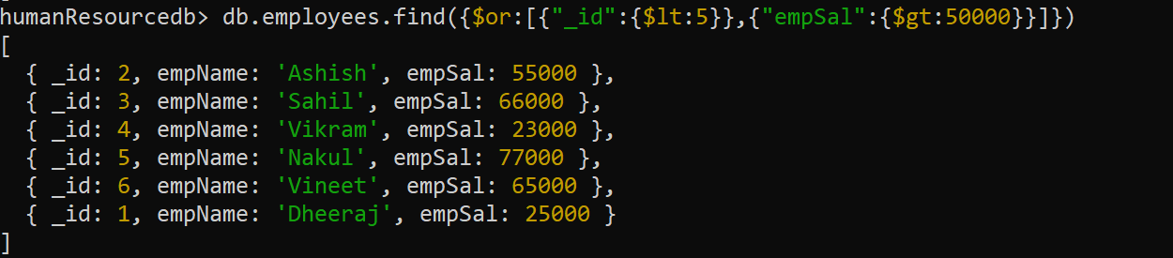
Specifying or
Fetching records of all employees , whose _id is less than 5 OR they have a salary of more than 50000.

Slide 18
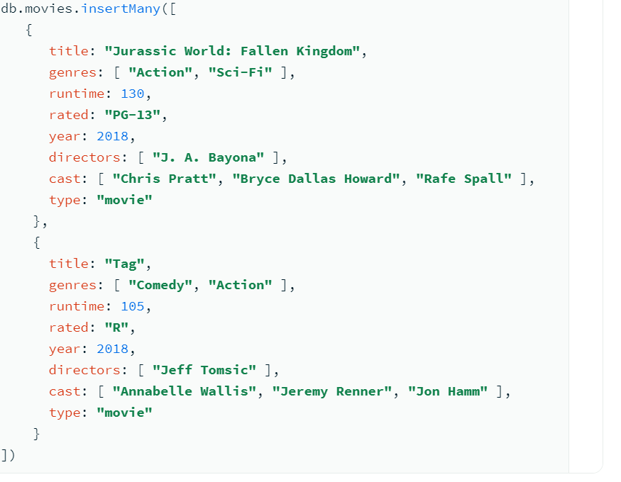
Sample database

Slide 19
Exercise 1
Return all movies where the title equals Titanic

Slide 20
Exercise 2
Return all movies which are either rated PG or PG-13

Slide 21
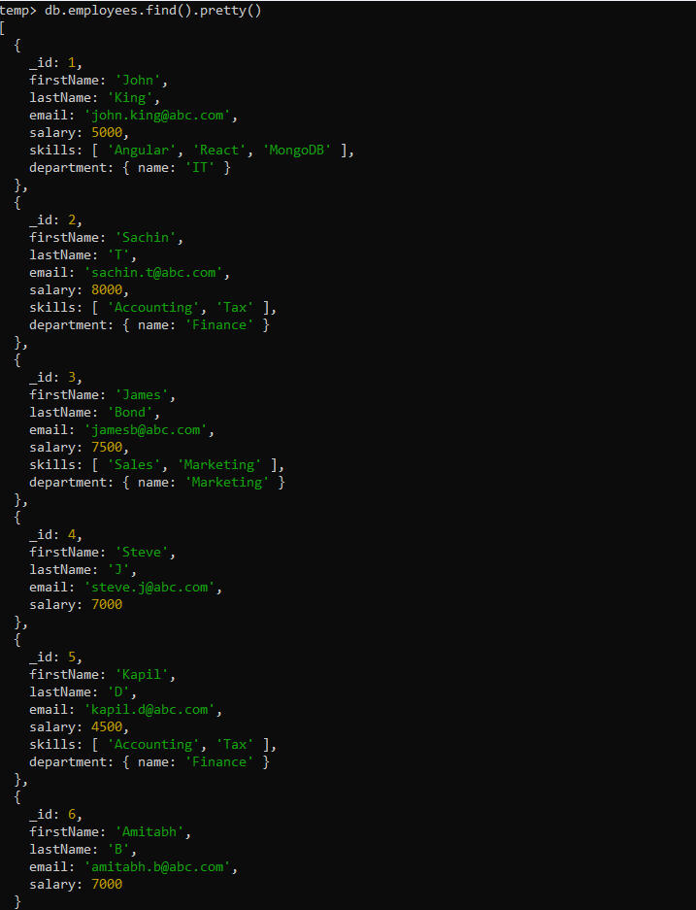
Sample database

Slide 22
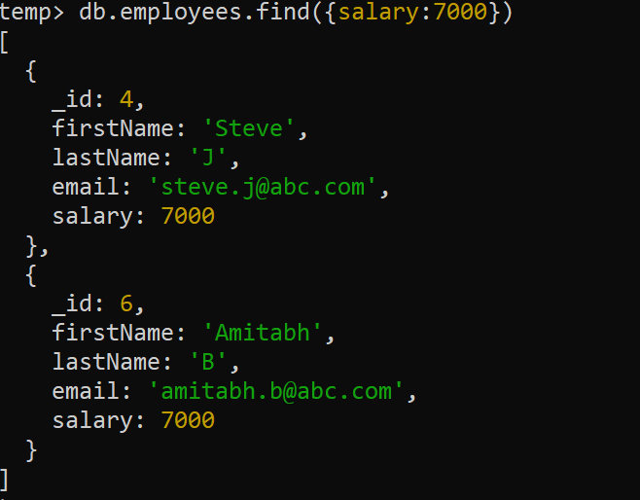
Exercise 1
Return all employees where salary is 7000

Slide 23
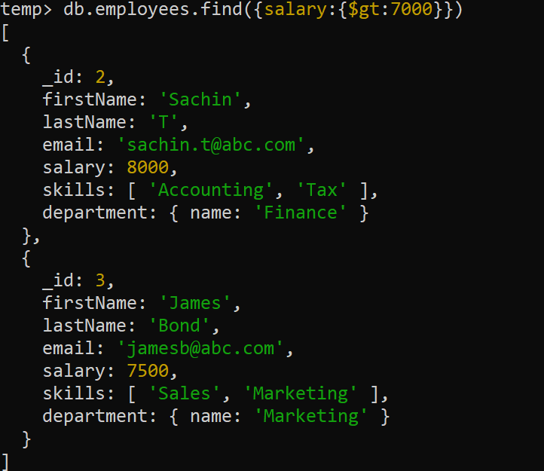
Exercise 2
Return all employees where salary is greater than 7000

Slide 24
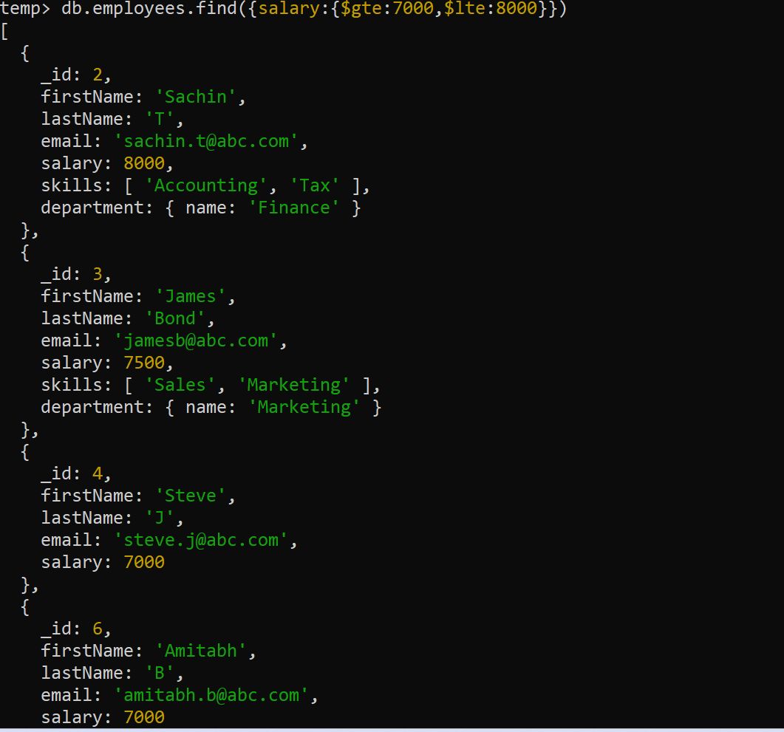
Exercise 3
Return all employees where salary is between 7000 and 8000

Slide 25
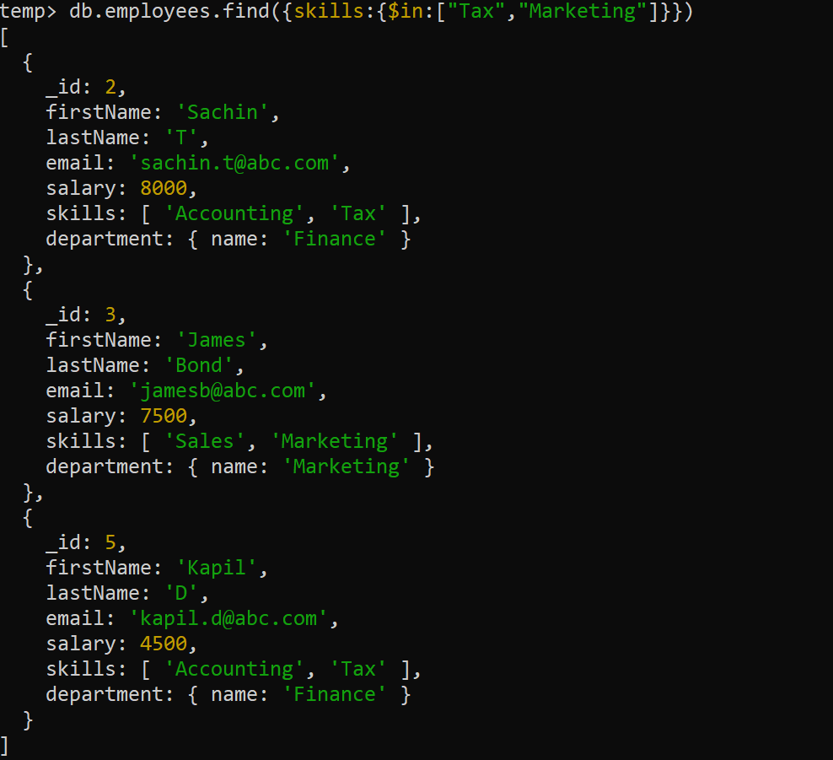
Exercise 4
Return all employees who have Tax or Marketing skills

Slide 26
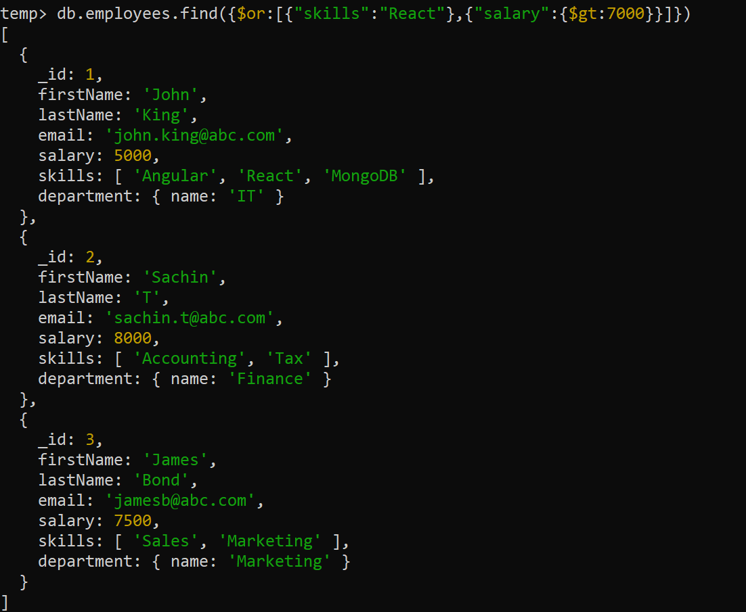
Exercise 5
Return all employees who either know React or have a salary greater than 7000

Slide 27
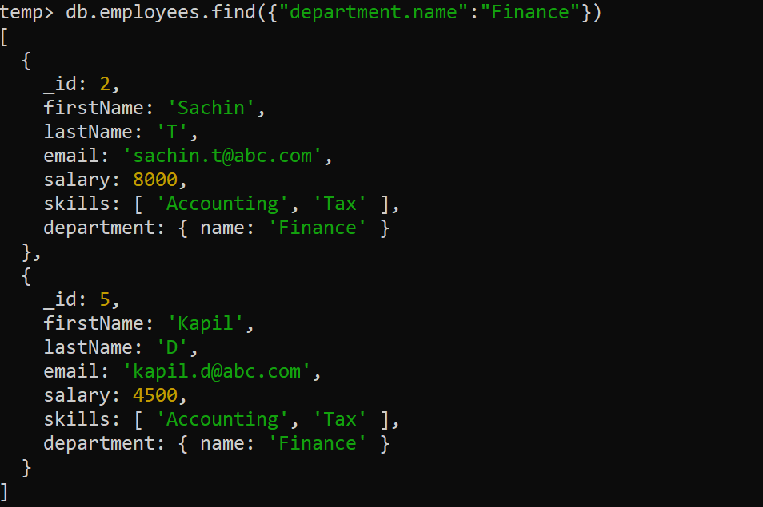
Exercise 6
Return all employees whose department is Finance.

Slide 28
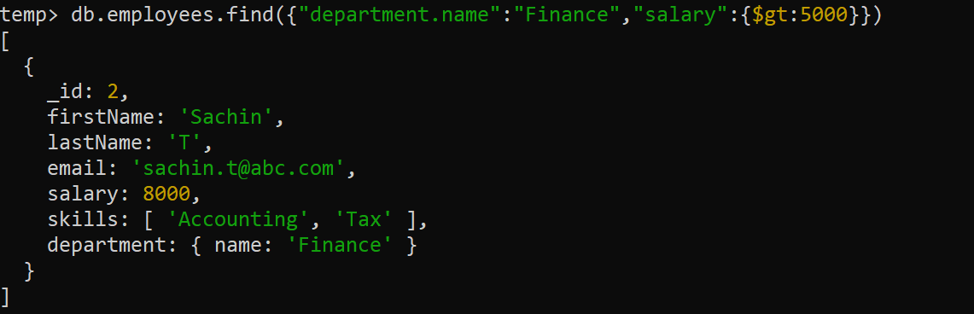
Exercise 7
Return all employees whose department is Finance and they earn more than 5000.

Slide 29
Using projection
We use the projection parameter to specify the fields to be included in the result.
The projection parameter format is : {<field>: <1 or true>, <field>: <1 or true>...} where 1 or true will include the field, and o or false will exclude the field in the result.

Slide 30
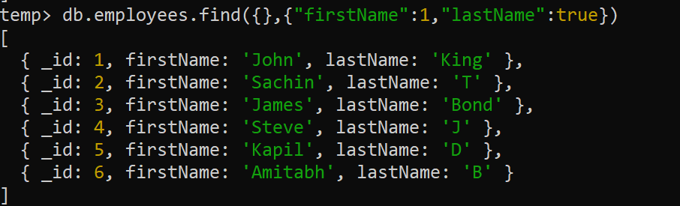
Exercise 8
Return firstName and lastName only for all employees

Slide 31
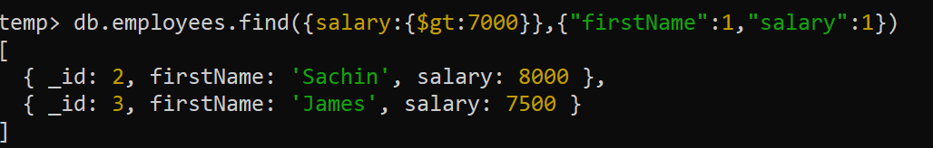
Exercise 9
Return firstName and salary of only those employees who earn more than 7000

Slide 32
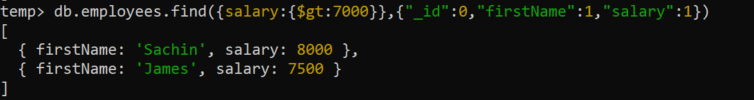
Exercise 10
Rewrite the previous query to exclude the field _id from the output

Slide 33
Using the “findOne()” method
The findOne() method returns the first document that is matched with the specified criteria.
Syntax:
db.<collection_name>.findOne(query,projection,options)
If no criteria is given it returns the first record.
If no record matches with the criteria then it returns null.

Slide 34
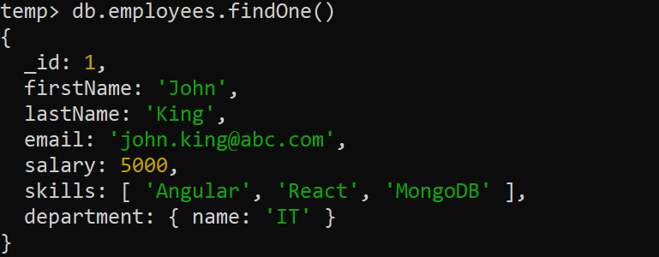
Exercise 11
Display the first document of employees collection.

Slide 35
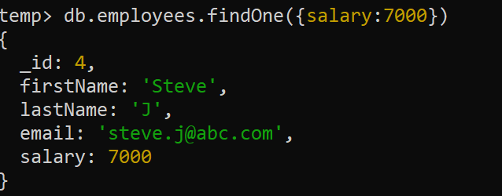
Exercise 12
Display the first document of employees collection with salary of 7000.

Slide 36
Exercise 13
Display the first document of employees collection with salary of 9000.

Slide 37
Exercise 14
Display the firstName of the first employee working in Finance department

